Slide 1
Data Mining
Yichun Zhou

Slide 2
Overview
What is Data Mining
Motivation of Data Mining
Origins of Data Mining
Data Mining Steps
Data Mining Tasks
Challenges
Open Source Tools
WEKA Demo

Slide 3
What is Data Mining?
Knowledge Discovery in Databases
The process of discovering patterns in large data sets involving methods at the intersection of machine learning, statistics, and database systems.

Slide 4

Examples of Data Mining
Look up phone number in phone directory
Search for information about “Amazon” on a search engine
Certain names are more prevalent in certain locations (O’Brien, O’Reilly... in one area)
Group together similar documents returned by search engine according to their context (e.g. Amazon rainforest, Amazon.com)

Slide 5
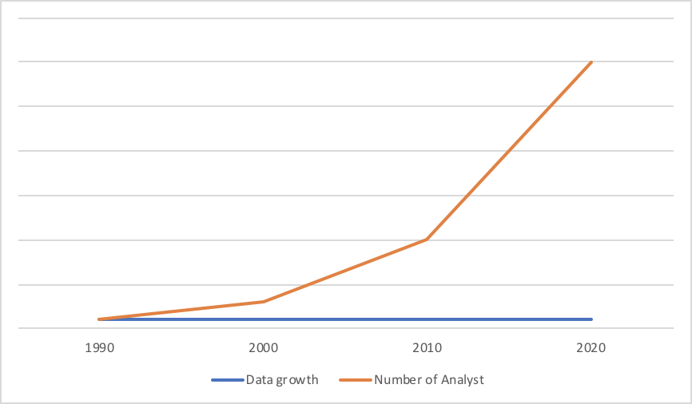
Motivation of Data Mining
“Hidden” information
Time consuming
Data is never analyzed
The Data Gap
--- data growth --- number of analysts
Notes:
orange line: data growth
blue line: number of analysts

Slide 6
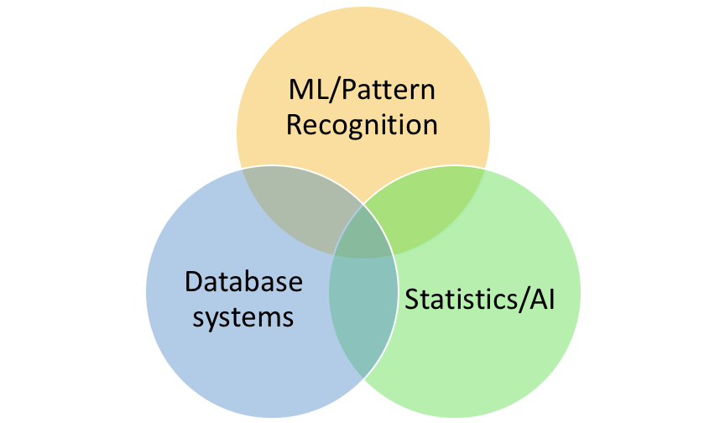
Origins of Data Mining
Draws ideas from machine learning/AI, pattern recognition, statistics, and database systems

Slide 7
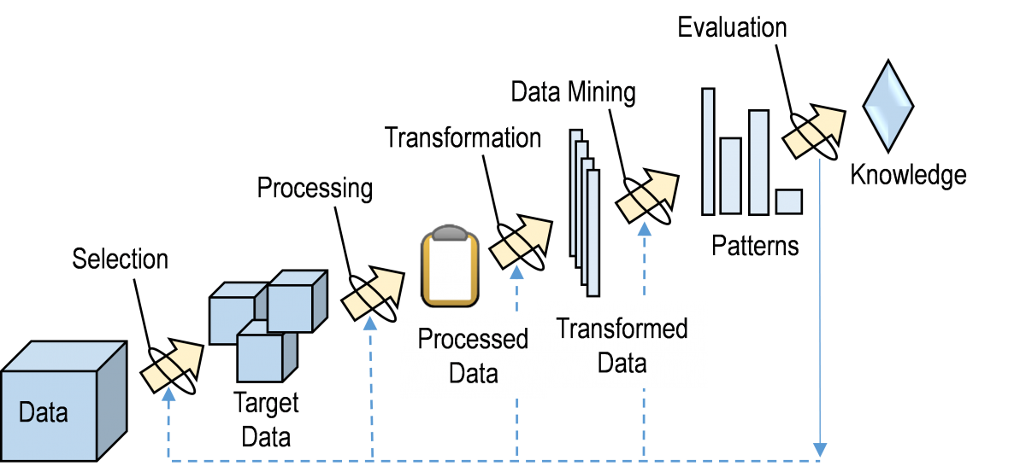
Steps of Data Mining

Slide 8
Data Mining Tasks
Prediction
Use some variables to predict unknown or future values of other variables.
Description
Find human-interpretable patterns that describe the data.

Slide 9
Data Mining Tasks Cont.
Classification [Predictive]
Regression [Predictive]
Deviation Detection [Predictive]
Clustering [Descriptive]
Association Rule Discovery [Descriptive]

Slide 10
Classification[Predictive]
Find a model for class attribute as a function of the values of other attributes.
Goal: assign a previously unseen record into a class as accurately as possible.

Slide 11
Classification Examples
Direct Marketing
Reduce cost of mailing by targeting a set of consumers likely to buy a new cell-phone product.
Predict tumor cells
Classify credit card transaction

Slide 12
Classification Techniques
Linear Discriminant Analysis
Neural Networks
Logistic Regression
Nearest Neighbor classifiers (KNN)
Decision Tree based Methods
Support Vector Machines (SVM)

Slide 13
Classification Techniques - KNN
Take the majority vote of class labels among the k-Nearest Neighbors
To calculate distance between two points, use Euclidean distance

Slide 14
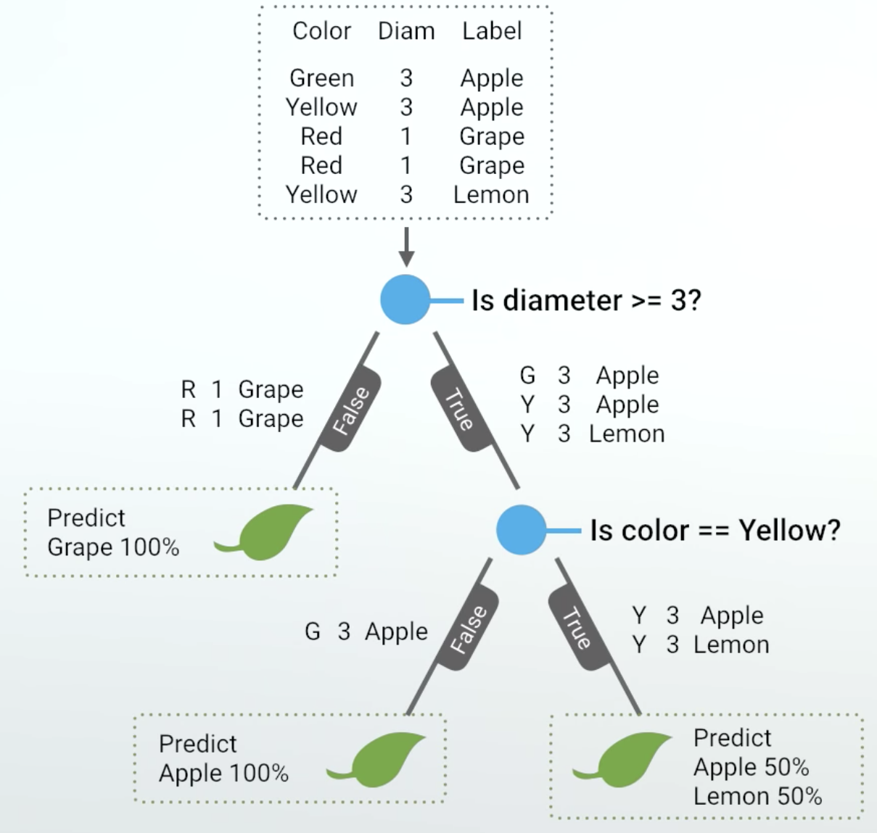
Decision Tree
Split the records based on an attribute test that optimizes certain criterion
Nodes with homogeneous class distribution are preferred
Measure impurity
Gini index
Entropy
Misclassification Error

Slide 15
SVM
Support Vector Machine (SVM)
Outputs an optimal hyperplane which categorizes new examples.
Hyperplane maximize the margin

Slide 16
Regression[Predictive]
Predict a value of a given continuous valued variable based on the values of other variables, assuming a linear or nonlinear model of dependency.
Example:
Predicting wind velocities as a function of temperature, humidity, air pressure, etc.

Slide 17

Deviation/Anomaly Detection[Predictive]
Detect significant deviations from normal behavior
Example:
Credit Card Fraud Detection

Slide 18
Clustering[Descriptive]
Among attributes of a set of data, find clusters such that
Data points in one cluster are more similar to one another.
Data points in separate clusters are less similar to one another.
Example: Document Clustering
To find groups of documents that are similar to each other based on the important terms appearing in them.

Slide 19
Clustering VS Classification
Inter-cluster distances are maximized
Intra-cluster distances are minimized
Clustering: group similar records together

Slide 20
Clustering VS Classification
Test point
Class 2
Class 1
Class 3
Test point
Classification: assign class label to unseen records

Slide 21
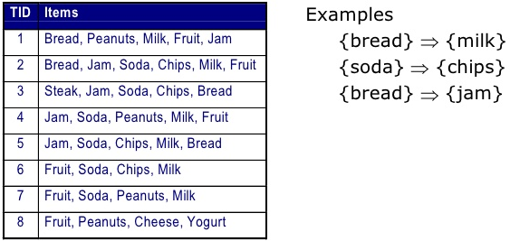
Association Rule Discovery [Descriptive]
In a set of records, find rules which will predict occurrence of an item based on occurrences of other items.
Notes:
Supermarket shelf management.
– Goal: To identify items that are bought together by sufficiently many customers.

Slide 22
Challenges of Data Mining
Scalability
Dimensionality
Complex and Heterogeneous Data
Data Quality
Data Ownership and Distribution
Privacy

Slide 23
Open Source Data Mining Tools
WEKA
KNIME
RapidMiner
R-Programming
Orange
Notes:
RapidMiner: Written in the Java Programming language, this tool offers advanced analytics through template-based frameworks.
KNIME: Written in Java and based on Eclipse, KNIME is easy to extend and to add plugins
R-Programming: It’s primarily written in C and Fortran. And a lot of its modules are written in R itself.
Orange: a Python-based tools with components for machine learning

Slide 24
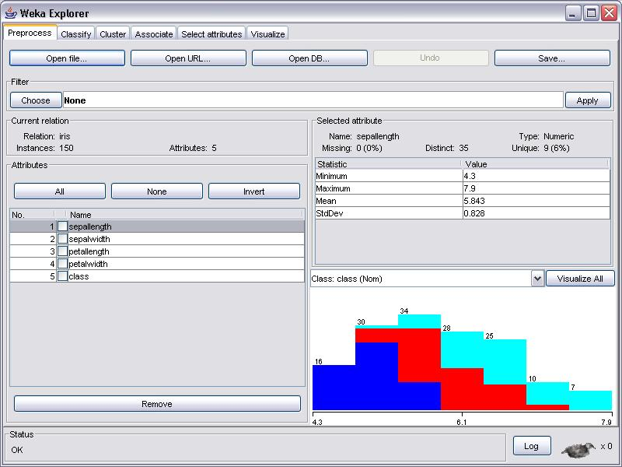
WEKA
Waikato Environment for Knowledge Analysis
University of Waikato, New Zealand.
JAVA
A collection of ML algorithms for data mining tasks.
Contains tools for
Data Preparation
Classification
Regression
Clustering
Association Rules Mining
Visualization

Slide 25
References
Downloading and installing Weka
https://www.cs.waikato.ac.nz/ml/weka/downloading.html
Several free online courses that teach data mining using Weka
https://www.cs.waikato.ac.nz/ml/weka/courses.html
https://www.youtube.com/user/WekaMOOC
https://en.wikipedia.org/wiki/Data_mining
https://www.sas.com/en_us/insights/analytics/data-mining.html
https://thenewstack.io/six-of-the-best-open-source-data-mining-tools/
https://orange.biolab.si/
https://www.r-project.org/
https://rapidminer.com/
https://www.knime.com/
https://behavior.lbl.gov/?q=node/11
http://inspirehep.net/record/1229769/plots
https://www.slideshare.net/zafarjcp/data-mining-association-rules-basics
https://www.ibm.com/developerworks/library/os-weka1/index.html
Xia, Z 2018, Artificial Intelligence, lecture notes, CS456, Western Kentucky University

